Slide 1
British Invasion and the Beatles
1958-1967

Slide 2
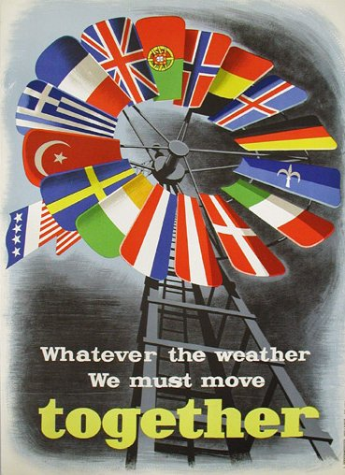
Marshall Plan’s effects
Sped up economic recovery in western Europe.
Kept communists out of governments.
Encouraged European integration.
Americanized Europe.
Provided markets for US goods.
Notes:
Source for image: https://commons.wikimedia.org/wiki/File%3AMarshall_Plan_poster.JPG

Slide 3
Post-WWII European recovery, Marshall Plan, 1948-1951
Country | 1948/49 ($ millions) | 1949/50 ($ millions) | 1950/51 ($ millions) | Cumulative ($ millions)
Iceland | 6 | 22 | 15 | 43
Portugal | 0 | 0 | 70 | 70
Ireland | 88 | 45 | 0 | 133
Turkey | 28 | 59 | 50 | 137
Switzerland | 0 | 0 | 250 | 250
Sweden | 39 | 48 | 260 | 347
Norway | 82 | 90 | 200 | 372
Greece | 175 | 156 | 45 | 376
Denmark | 103 | 87 | 195 | 385
Austria | 232 | 166 | 70 | 468
Belgium and Luxembourg | 195 | 222 | 360 | 777
Netherlands | 471 | 302 | 355 | 1128
Italy and Trieste | 594 | 405 | 205 | 1204
West Germany | 510 | 438 | 500 | 1448
France | 1085 | 691 | 520 | 2296
United Kingdom | 1316 | 921 | 1060 | 3297
Totals | 4,924 | 3,652 | 4,155 | 12,731
Notes:
Source: https://en.wikipedia.org/wiki/Marshall_Plan#Expenditures

Slide 4
Post-WWII Britain
Baby boom
Relatively weak economy
UK had to borrow money from Canada, USA, and IMF.
Rationing continued until 1954.
National Service (conscription) ended in 1960.
Many more teenagers, proportionally
Old empire dying, de-colonization, Suez crisis, 1956

Slide 5
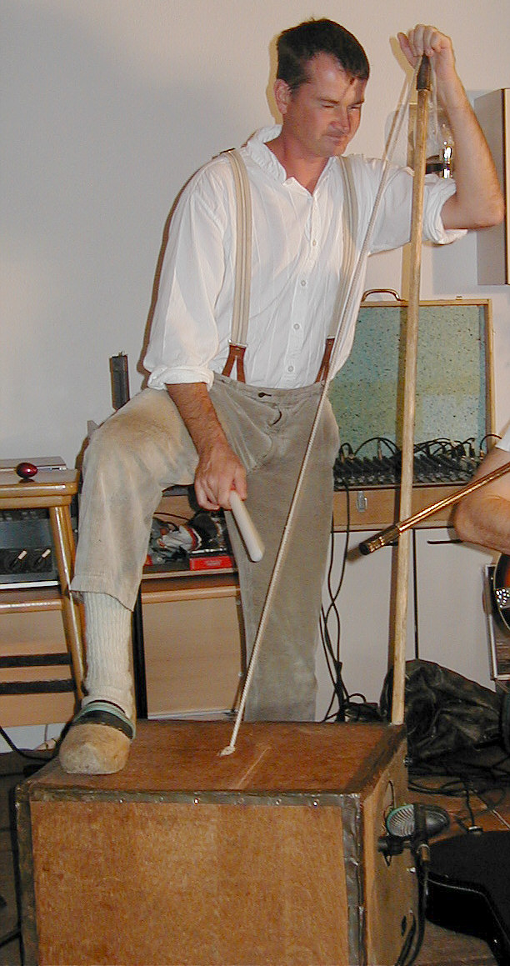
Skiffle in United Kingdom, 1950s
Originated in New Orleans Jazz and Chicago, 1930s
Came out of Trad Jazz.
Skiffle: to make a mess of something or to hurry.
Lonnie Donegan, “Midnight Special” (Lead Belly) [link]
Deformalized music in UK.
Made making music accessible to most.
Jimmy Page’s skiffle band [link]

Slide 6
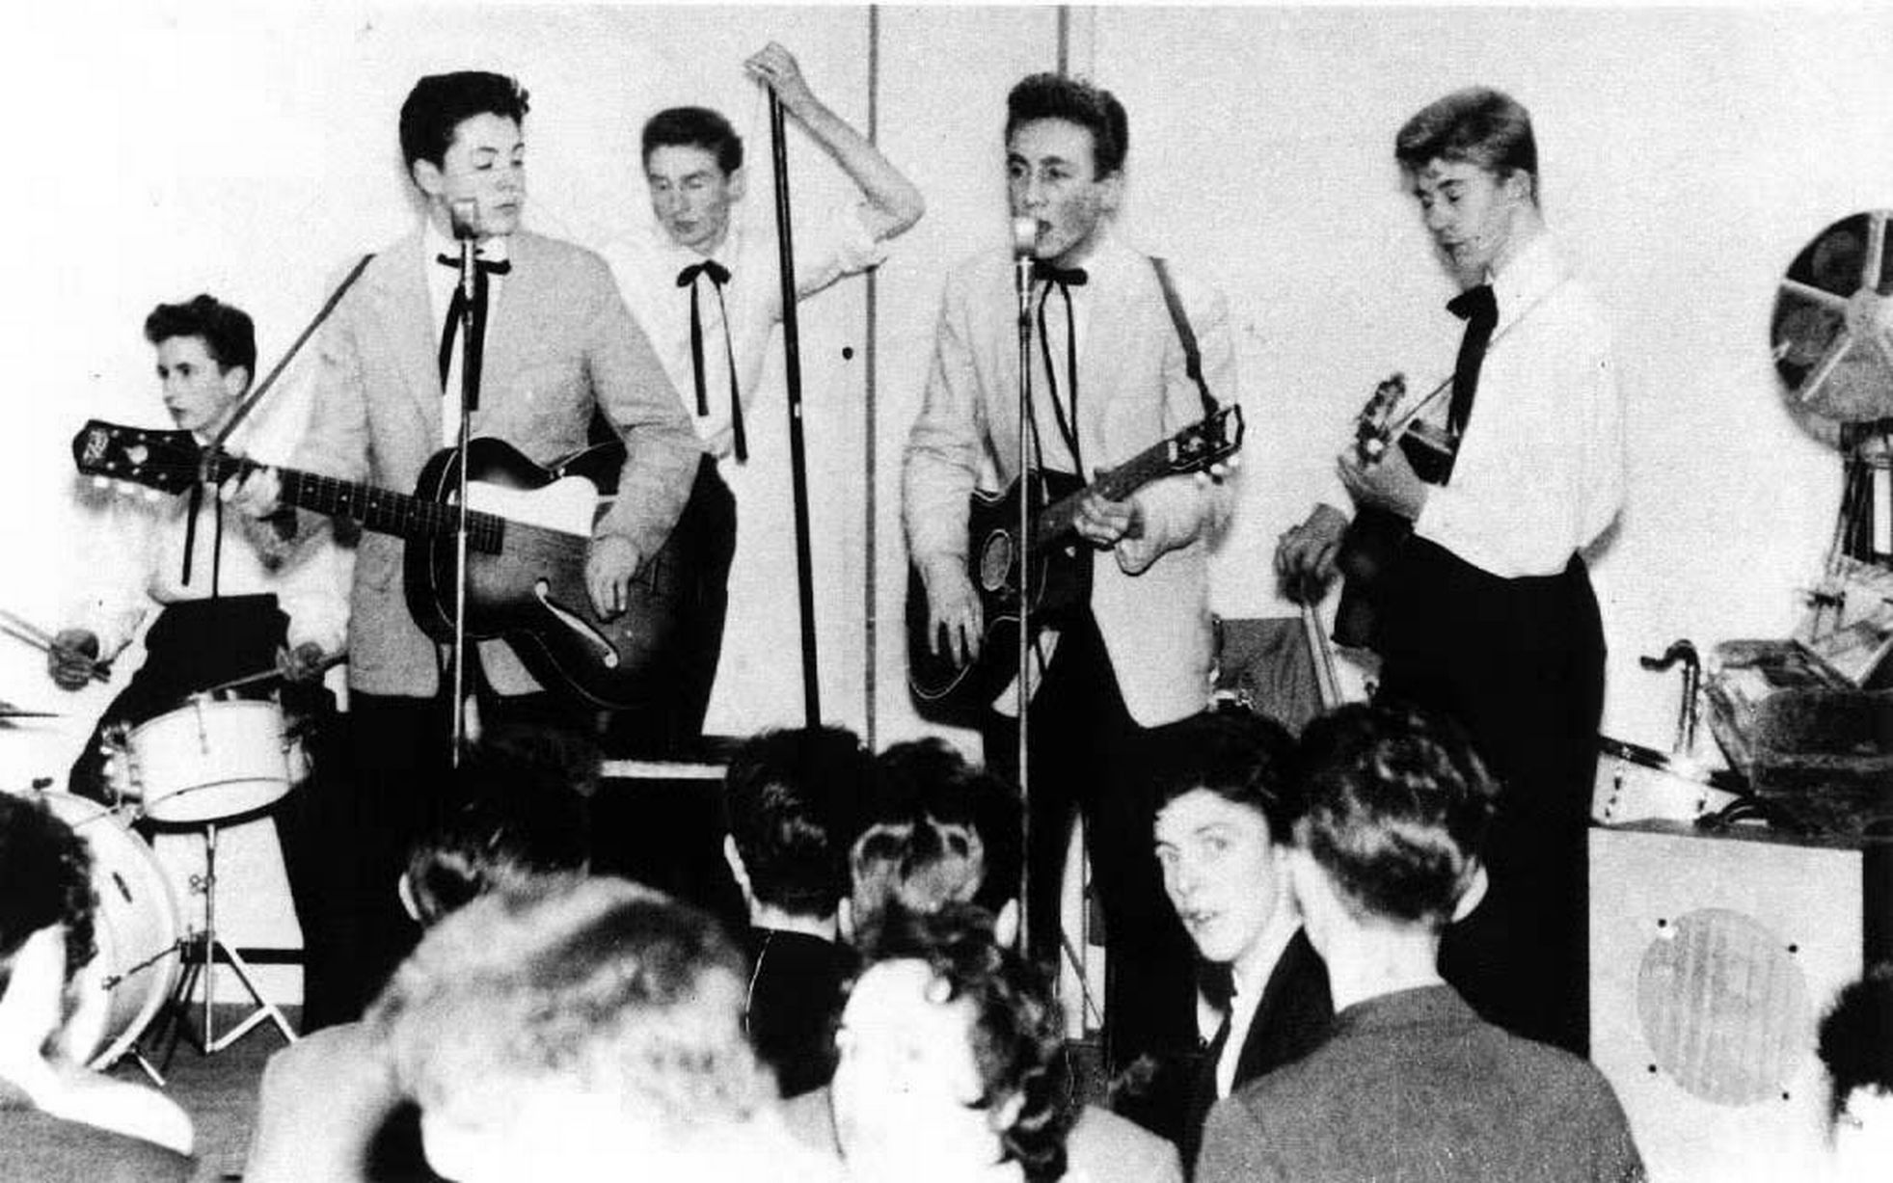
The Quarrymen
Liverpool
John Lennon, aged 16
Quarry Bank School
Formed in March 1957
Paul McCartney joined in July 1957 (aged 15).
George Harrison admitted, spring 1958 (aged 15).
Holly and the Crickets toured UK in Jan-Feb 1958.
“That’ll be the day!” 14 July 1958

Slide 7
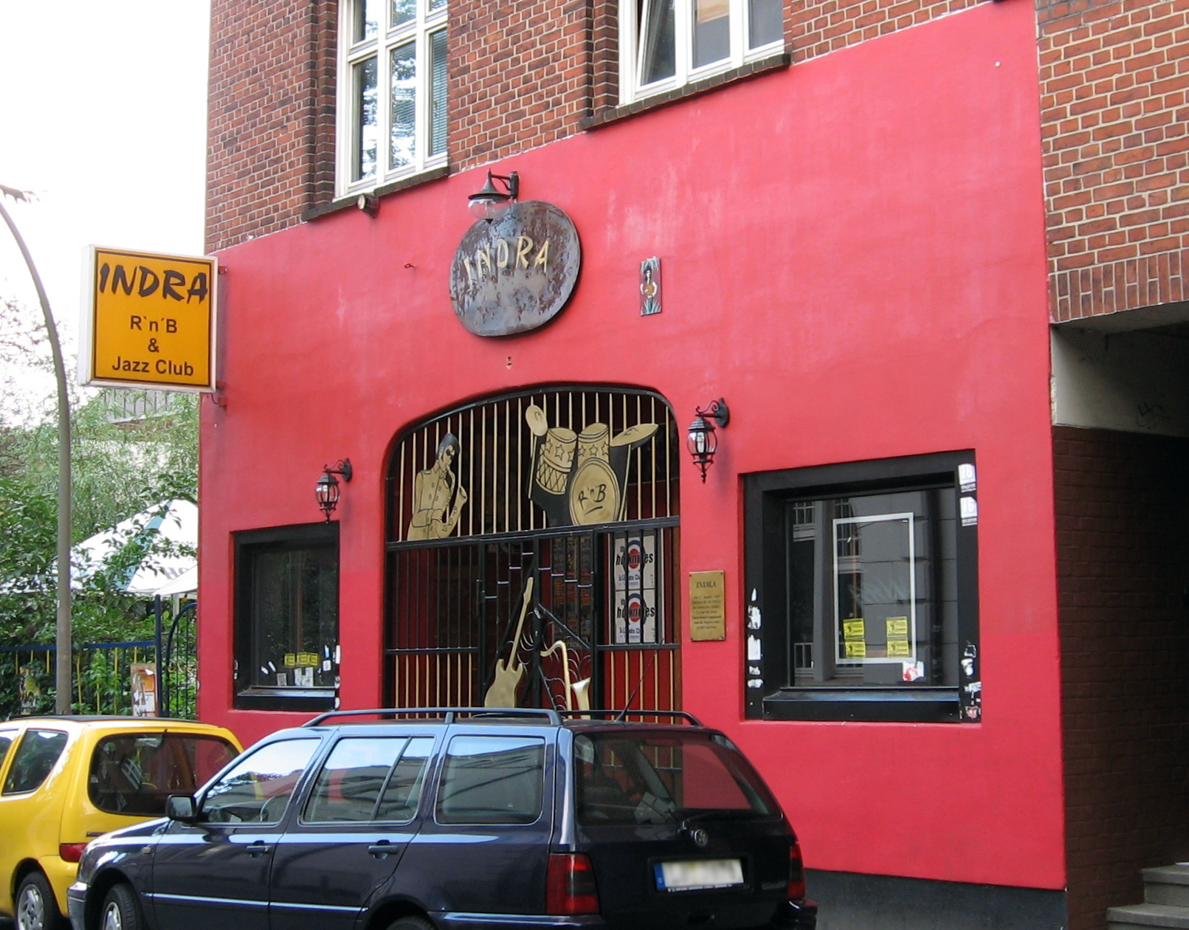
Hamburg, 1960-1962
The Crickets
The Beatals
The Silver Beetles
The Beatles (July 1960)
Alan Williams (manager)
Pete Best
Stuart Sutcliffe (Liverpool College of Art)
Wild life
Indra Club
Tons of practice

Slide 8
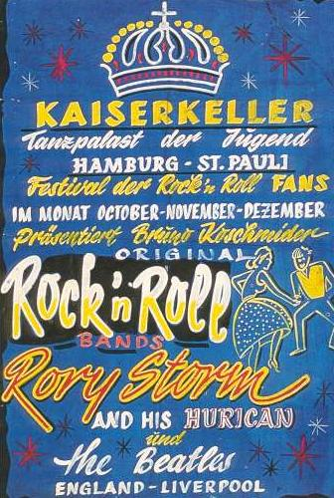
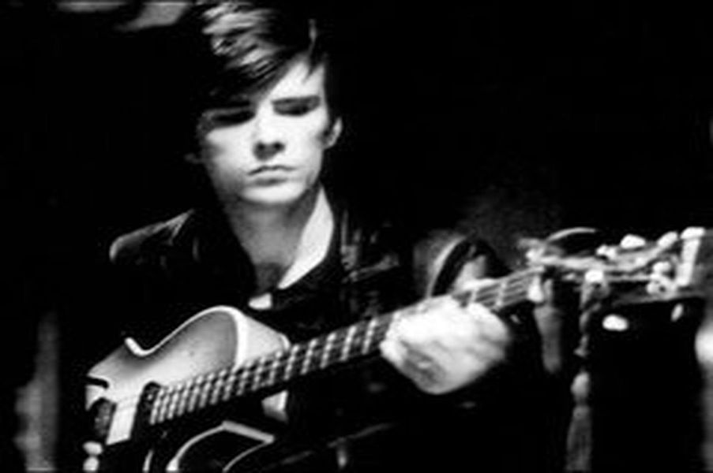
Hamburg, 1960-1962
Tons of practice, learning their style
Stuart Sutcliffe: bought their bass guitar [letter from John].

Slide 9
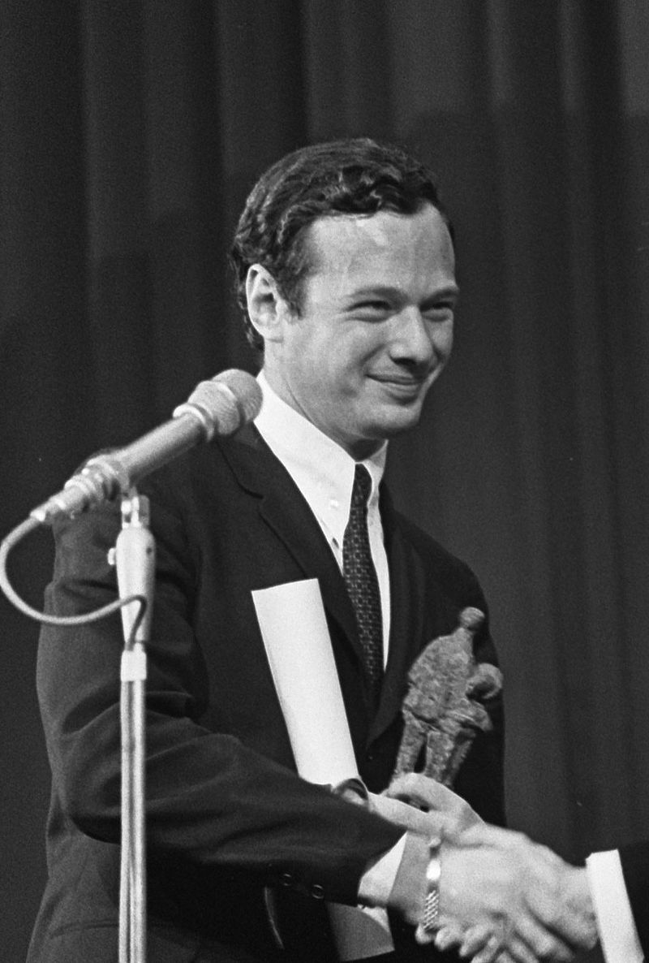
Cavern Club, Liverpool, 1961-1963
Merseybeat
First performed there as The Quarrymen, 1957
1961-1963: The Beatles performed there 292 times: [link].
November 1961: Brian Epstein heard them there.
January 1962: Epstein became their manager:
Mona Best supported the deal.
McCartney’s father opposed “the Jew”.
Mimi (John’s aunt) opposed it.
Five-year contract: Epstein got 15-25%.
"I was immediately struck by their music, their beat and their sense of humour on stage – and, even afterwards, when I met them, I was struck again by their personal charm. And it was there that, really, it all started".
Notes:
Quote source: http://www.brianepstein.com/brian.html

Slide 10
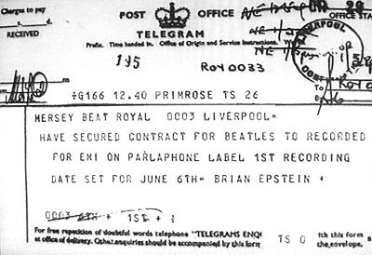
EMI-Parlophone recording contract
Epstein tried many other companies first.
Finally, contacted George Martin at EMI’s Parlophone.
May have threatened to withdraw his business, but Martin claimed Epstein was very convincing.
Contract gave The Beatles one penny per record sold.
June 1962 recording began at Abby Road Studios.
Summer 1962: fired Pete Best, hired Ringo Starr (Richard Starkey).

Slide 11
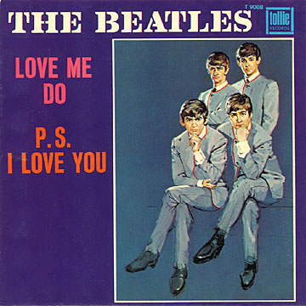
“Love Me Do” October 1962
Written before “The Beatles”
Recorded three times, each with different drummer
Ringo Starr version: https://www.youtube.com/watch?v=1Au_QW5MJNI
Reached number 17 in UK
After USA tour, hit number 1!

Slide 12
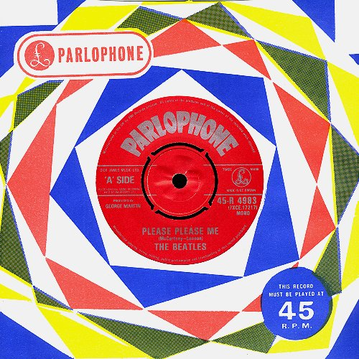
“Please Please Me”, January 1963
Reached number 1 on New Musical Express and Melody Maker.
George Martin found the original version “very dreary”.
Roy Orbison, “Only the lonely”: https://www.youtube.com/watch?v=UTR2IlAJEyQ
Wanted them to record “How do you do it?” written by Mitch Murray.
Band insisted on recording their own material.
https://www.youtube.com/watch?v=czw8eqepir8

Slide 13
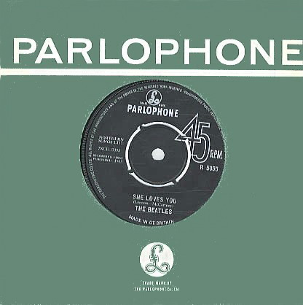
“She Loves You” (August 1963)
Biggest hit of the 1960s in UK.
October 1963: The Beatles performed on “Sunday Night at the Palladium”.
Lennon: “For our last number, I'd like to ask your help. Would the people in the cheaper seats clap your hands. And the rest of you, if you'll just rattle your jewelry.”
Sold one million copies by late November 1963.
[link]
Beatlemania tripped into full gear.
9 February 1964: Ed Sullivan Show [link]

Slide 14
Introducing… the Beatles
No. | Title | Lead vocals | Length
1. | "I Saw Her Standing There" | Paul McCartney | 2:50
2. | "Misery" | Lennon/McCartney | 1:48
3. | "Anna (Go to Him)" (Arthur Alexander) | John Lennon | 3:00
4. | "Chains" (Gerry Goffin, Carole King) | George Harrison | 2:25
5. | "Boys" (Luther Dixon, Wes Farrell) | Ringo Starr | 2:28
6. | "Love Me Do | McCartney/Lennon | 2:19
No. | Title | Lead vocals | Length
1. | "P.S. I Love You" | Paul McCartney | 2:04
2. | "Baby It's You" (Burt Bacharach, Mack David, Barney Williams) | John Lennon | 2:41
3. | "Do You Want to Know a Secret" | George Harrison | 1:59
4. | "A Taste of Honey" (Ric Marlow, Bobby Scott) | Paul McCartney | 2:05
5. | "There's a Place" | Lennon/McCartney | 1:53
6. | "Twist and Shout" (Phil Medley, Bert Russell) | John Lennon | 2:33

Slide 15
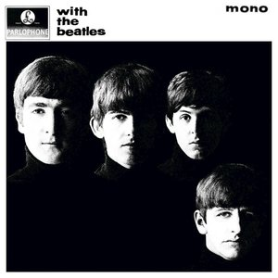
With the Beatles, 22 Nov. 1963
Included three Motown hits:
“Please Mr Postman” The Marvelettes
“You really got a hold on me,” Smokey Robinson and the Miracles
“Money,” Barrett Strong (written by Berry Gordy and Janie Bradford)
Gordy Berry initially tried to extract huge money from Brian Epstein.

Slide 16
Beatlemania! (1963-1970)
Fandom meant record sales:
1963-1970: there was a Beatles’ single at the number one spot in USA for 59 of those weeks; every sixth week, or about nine number one singles per year.
Beatles’ LPs topped LP charts for 116 weeks, 1963-1970, one every three weeks.
https://www.youtube.com/watch?v=VLvTq6FdOj4
Hard Day’s Night (1964, dir. Richard Lester): https://www.youtube.com/watch?v=RK15mkRWf4c&list=PLi67X2TyUMJudNRmP4YJCaaIDD5trh_FV

Slide 17
The Beatles’ 1966 USA tour and Jesus Christ
“Christianity will go,” he said. “It will vanish and shrink… We're more popular than Jesus now - I don't know which will go first, rock and roll or Christianity.” Maureen Cleave, The London Evening Standard, 4 March 1966
https://www.youtube.com/watch?v=ONYVxatB1U4
John in 1978: “My life with the Beatles had become a trap… I always remember to thank Jesus for the end of my touring days; if I hadn't said that the Beatles were 'bigger than Jesus' and upset the very Christian Ku Klux Klan, well, Lord, I might still be up there with all the other performing fleas! God bless America. Thank you, Jesus.”
1968: founded Apple Records
Notes:
Source: http://www.telegraph.co.uk/culture/music/rockandjazzmusic/3646983/The-John-Lennon-I-knew.html

Slide 18
Beatles’ end?
1966: quit touring
Rubber Soul (1965)
Revolver (1966)
Sgt. Pepper's Lonely Hearts Club Band (1967)
Brian Epstein’s death, August 1967
The Beatles ("The White Album", 1968)
Yellow Submarine (1969)
Abbey Road (1969)
Let It Be (1970)

Slide 19
The Rolling Stones, 1962 to present
Initial line-up:
Mick Jagger (lead vocals, harmonica)
Keith Richards (guitar)
Brian Jones (guitar, harmonica)
Ian Stewart (piano)
Bill Wyman (bass)
Charlie Watts (drums)
Very focused on electric blues, rhythm and blues, rockabilly music (Muddy Waters, Chuck Berry, Little Richard, Buddy Holly)
Alexis Korner’s Electric Blues Inc.
Early songs were covers.
First single, Chuck Berry’s “Come on”, 1963: https://www.youtube.com/watch?v=UCWxU2pln2k
Toured with Bo Diddley, Little Richard, and The Everly Brothers

Slide 20
The Rolling Stones
Nov. 1963: Second record: “I want to be your man!” written by Lennon and McCartney for the Stones.
Reached number 12 on the charts.
https://www.youtube.com/watch?v=DJCkbbMnEPg
Third single, Buddy Holly’s “Not Fade Away” (February 1964)
Reached number 3 on the charts.
Appeared on the Michael Douglas Show, 1964:
https://www.youtube.com/watch?v=P6RWnGQ3XqQ

Slide 21
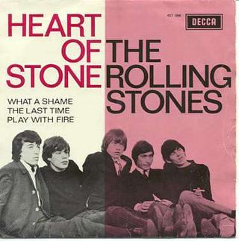
The Rolling Stones
Richards and Jagger had to be convinced to write their own music.
First hit song: “Heart of Stone,” December 1964
https://www.youtube.com/watch?v=5uIBNXrfnyE

Slide 22
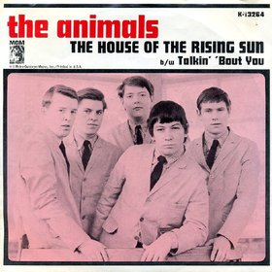
The Animals, 1963-1969
Newcastle upon Tyne
Eric Burdon
Alan Price (organ and keyboards)
Hilton Valentine (guitar)
John Steel (drums)
Bryan "Chas" Chandler (bass)
Line-up changed many times, except Burdon
June 1964: “House of the Rising Sun”
https://www.youtube.com/watch?v=eb3vEZZQO_I

Slide 23
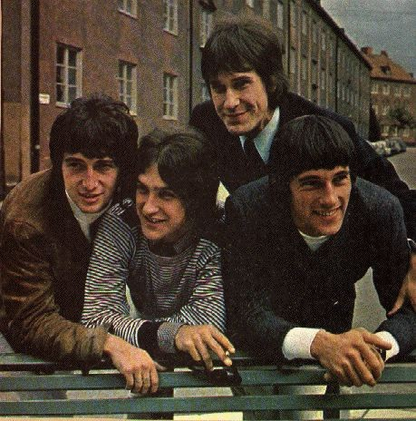
The Kinks, 1963-1996
Ray Davies (rhythm guitar, lead vocals, main writer)
Dave Davies (lead guitar, vocals)
Pete Quaife (bass guitar)
Mick Avory (drums)
First hit, August 1964: “You really got me!”
https://www.youtube.com/watch?v=fTTsY-oz6Go

Slide 24
The Kinks, 1963-1996
October 1964: “All day and all of the night”
https://www.youtube.com/watch?v=fOGMRnKl5co
Hectic touring: Australia, New Zealand, USA, India
Cardiff, 19 May 1965: Dave Davies and Mick Avory fought on stage after “Your really got me!” (Davies got 16 stitches)
After summer USA tour, American Federation of Musicians refused permits for the group to appear in concerts for the next four years.
Cut off a major market.

Slide 25
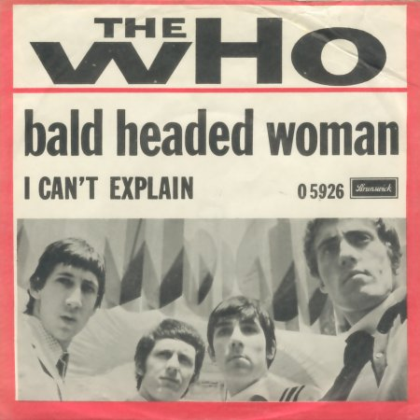
The Who, 1964-1982
Pete Townshend (lead guitar, vocals, writer)
Roger Daltrey (vocals, guitar)
John Entwhistle (bass guitar)
Keith Moon (drums, crazy)
Mod Scene
December 1964: “I can’t explain”
Jimmy Page (rhythm guitar)
https://www.youtube.com/watch?v=h3h--K5928M

Slide 26
“My Generation” October 1965
The Queen Mother had Townshend’s old car (1935 Packard Hearse) towed from a street in Belgravia.
The Kinks “All Day and all of the night”
John Lee Hooker's "Stuttering Blues”
“Why don’t you all just f…… ade away?”
Became the anthem of 1960s generation.
https://www.youtube.com/watch?v=594WLzzb3JI
https://www.youtube.com/watch?v=tdkROH7Exyg
“People try to put us d-down
(Talkin' 'bout my generation)
Just because we g-g-get around
(Talkin' 'bout my generation)
Things they do look awful c-c-cold
(Talkin' 'bout my generation)
I hope I die before I get old
(Talkin' 'bout my generation)”

